Slide 1
Data Structures and Algorithms
Trees
Part I: General Tree Concepts
Mark Allen Weiss: Data Structures and Algorithm Analysis in Java

Slide 2
Objectives
Students will learn about
  Tree Data Structure
  Properties of a Tree
  Types of Tree
  Representation
  Binary trees
  Traversals
  Expression trees

Slide 3
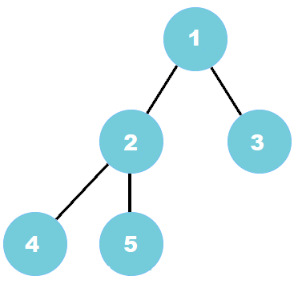
What is Tree data structure?
A tree is a non-linear type of data structure that organizes data hierarchically.
It consists of nodes connected by edges. Each node contains a value and may or may not have a child node.
When operations are performed in a linear data structure, the complexity rises as the data size increases
the tree data structure provides much quicker access to the data which is non-linear.

Slide 4
Why Tree?
One reason to use trees might be because you want to store information that naturally forms a hierarchy.
For example, the file system on a computer
If we organize keys in form of a tree (with some ordering e.g., BST), we can search for a given key in moderate time (quicker than Linked List and slower than arrays).
Self-balancing search trees like AVL and Red-Black trees guarantee an upper bound of O(Logn) for search.
We can insert/delete keys in moderate time (quicker than Arrays and slower than Unordered Linked Lists)

Slide 5
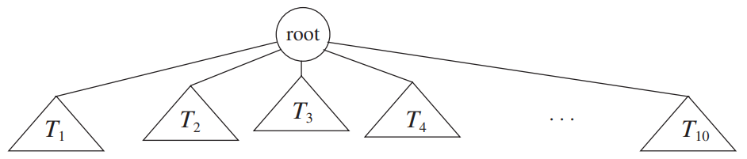
Tree
Tree consists of a distinguished node r, called the root, and zero or more non-empty (sub)trees T1, T2, ... , Tk, each of whose roots are connected by a directed edge from r.

Slide 6
Definitions
tree - a non-empty collection of vertices & edges
vertex (node) - can have a name and carry other associated information
path - list of distinct vertices in which successive vertices are connected by edges
  any two vertices must have one and only one path between them else its not a tree
a tree with N nodes has N-1 edges

Slide 7
Definitions
root - starting point (top) of the tree
parent (ancestor) - the vertex “above” this vertex
child (descendent) - the vertices “below” this vertex
Siblings - Nodes with the same parent
Every node except the root has one parent

Slide 8
Definitions
leaves (terminal nodes) - have no children
level - the number of edges between this node and the root
Path - from node n1 to nk, it is defined as a sequence of nodes n1, n2, ... , nk such that ni is the parent of ni+1 for 1 ≤ i < k
Length - of the path is the number of edges on the path
Notes:
ordered tree - where children’s order is significant

Slide 9
Definitions
Depth of a node - the length of the path from the root to that node
  root: depth 0
Height of a node - the length of the longest path from that node to a leaf
  any leaf: height 0

Slide 10
Definitions
Depth of a tree: is the length between the deepest leaf to root.
  equal to the depth of the deepest leaf
Height of a tree: The length of the longest path from the root to a leaf
  equal to the height of root
Depth of a tree is equal to height of a tree

Slide 11
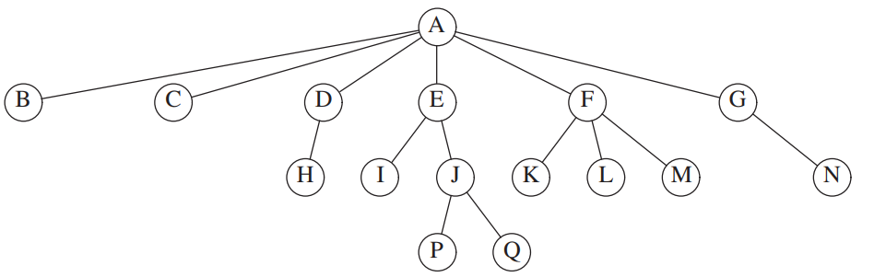
A tree

Slide 12
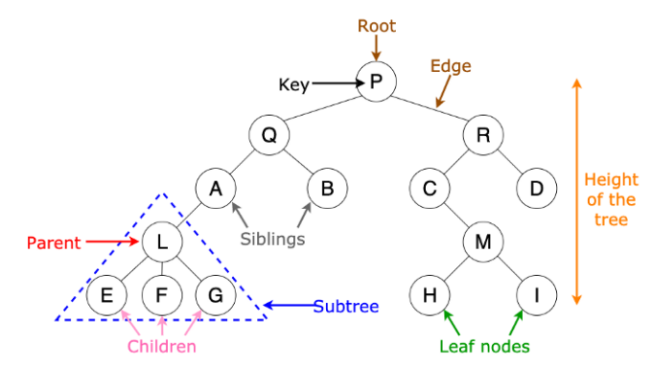
Tree structure

Slide 13
Trees - Example
Level
root
E
0
1
A
R
E
Child (of root)
A
S
T
2
Leaves or terminal nodes
Depth of T: 2
Height of T: 1
M
P
L
E
3

Slide 14
Properties of tree
A tree can contain no nodes or it can contain one special node called the root with zero or more subtrees.
Every edge of the tree is directly or indirectly originated from the root.
Every child has only one parent, but one parent can have many children.

Slide 15
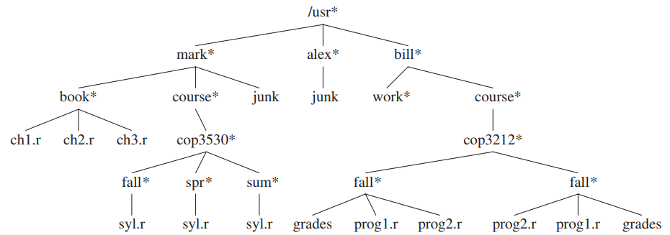
Application

Slide 16
Tree Implementation
Class TreeNode
{
Object element;
TreeNode firstChild;
TreeNode nextSibling;
}
The solution is simple: Keep the children of each node in a linked list of tree nodes.

Slide 17
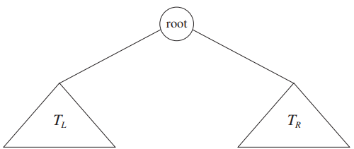
Binary Tree
A binary tree is a tree in which no node can have more than two children.
Tree in which each node has at most two children
consists of
  a root
  left subtree (may be empty)
  right subtree (may be empty)
  A
/ \
B C
/ \ \
D E F

Slide 18
Binary Tree
S
P
O
I
N
S
M
A
B
D
N

Slide 19
Height of a Full Binary Tree
L 0
L 1
L 2
L 3
At each level the number of the nodes is doubled.
total number of nodes: 1 + 2 + 2² + 2³ = 2⁴ - 1 = 15

Slide 20
Nodes and Levels in a Complete Binary Tree
Number of the nodes in a tree with M levels:
1 + 2 + 2² + …. 2^{M} = 2 ^{(M+1)} - 1 = 2*2^{M} - 1

Slide 21
Binary Tree Implementation
Class BinaryNode {
Object Element; // the data in the node
BinaryNode left; // Left child
BinaryNode right; // Right child
}
Binary Tree node is similar in structure to node of doubly linked list

Slide 22
Binary Tree – Operations
InsertLeft
  an error occurs if v already has a left child
InsertRight
  an error occurs if v already has a right child
Remove
  Remove node and replace with child
  an error occurs if v has 2 children
Traverse

Slide 23
Traversals
1
Traverse it using
Preorder (NLR)
Inorder (LNR)
Postorder (LRN)
3
7
5
8
9
10
4
6
11
12
CS 103

Slide 24
Binary Tree – Preorder Traversal
Root
Left
Right
C
O
T
M
E
R
P
U
L
A
N
First letter - at the root
Last letter – at the rightmost node
D

Slide 25
Preorder Algorithm
preorderVisit(tree)
{
if (current != null)
{
process (current);
preorderVisit (left_tree);
preorderVisit (right_tree);
}
}

Slide 26
Binary Tree – Inorder Traversal
Left
Root
Right
U
P
T
O
R
E
C
M
A
L
D
First letter - at the leftmost node
Last letter – at the rightmost node
N

Slide 27
Inorder Algorithm
inorderVisit(tree)
{
if (current != null)
{
inorderVisit (left_tree);
process (current);
inorderVisit (right_tree);
}
}

Slide 28
Binary Tree – Postorder Traversal
Left
Right
Root
D
P
N
M
A
U
C
O
L
T
R
First letter - at the leftmost node
Last letter – at the root
E

Slide 29
Postorder Algorithm
postorderVisit(tree)
{
if (current != null)
{
postorderVisit (left_tree);
postorderVisit (right_tree);
process (current);
}
}

Slide 30
Traversals
1
Traverse it using
Preorder (NLR)
Inorder (LNR)
Postorder (LRN)
3
7
5
8
9
10
4
6
11
12
CS 103

Slide 31
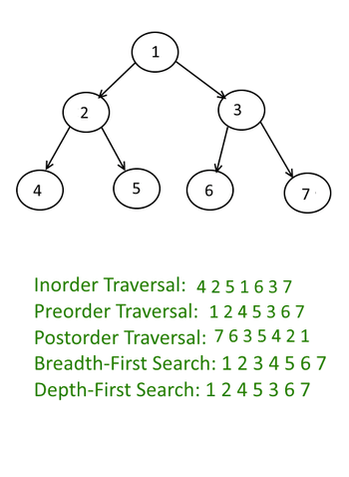
Traversing
Traverse it using
Inorder (LNR)
Preorder (NLR)
Postorder (LRN)

Slide 32
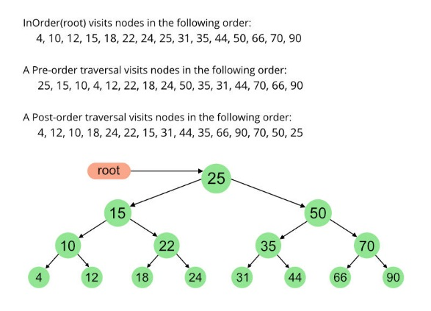
Activity Try to Travers !
In Order
Pre Order
Post Order

Slide 33
Another example

Slide 34
Application of Binary Tree
One of the principal uses of binary trees is in the area of compiler design like Expression Tree
An important application of binary trees is their use in searching like Binary Search Tree – BST

Slide 35
Review Questions
Question 1:
How height and depth of the tree are calculated?
Question 2:
What are different schemes of traversing a binary tree?

